Slide 1
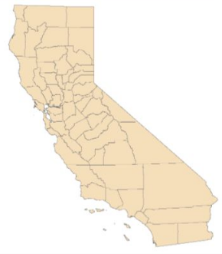
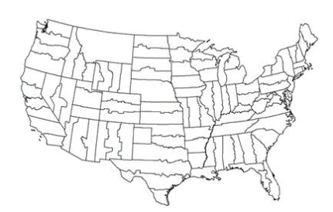
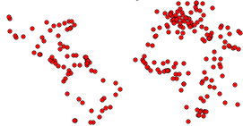
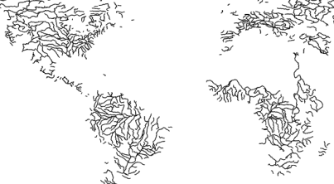
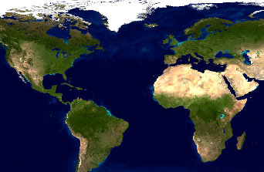
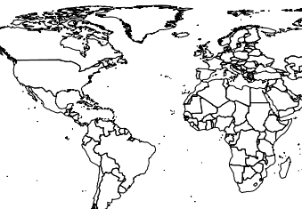
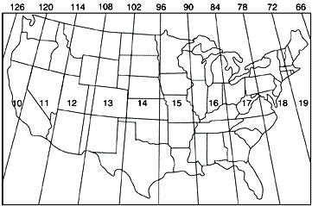
General GIS Quick Reference
Earth
Earth is spinning and bulges at the equator into an Oblate Spheroid
Diameter at equator: ~12,756km (~7,926 miles)
At poles: ~12,715.43 km (~7,901 miles)
Common Units:
IS: Kilometers, Meters
English: Feet, Miles
- Nautical: Depth: fathoms (6 feet), nautical miles (~1.15 miles)
Geographic data projected flat
Coordinates
Geographic: Latitude, Longitude (Y,X)
- Prime meridian at Greenwich England, parallels
DMS: 44°34′14.81″N 123°16′33.59″W
DD: 44.570781, -123.275997
Projected: Easting, Northing (X,Y)
UTM: 521914 E, 4935308 N
Accuracy:
30 meters=about 1 second at the equator
1 meter in DD requires at least 5 fractional digits
1 meter in DMS requires 2 fractional digits
1 meter in UTM requires no fractional digits
Spatial/Coordinate Reference System (SRS or CRS)
Datums – define reference surface for spatial data
Modern datums define “flattening” at the poles
Projections
Geographic – used as projection
UTM
State Plane
California Teale Albers
Google/World Mercator
Using:
If a CRS is missing from data:
Find out what it is and “Define” it
If two layers have different CRSes:
“Project” them into the same CRS
California Teale Albers
State Plane Zones
Points
Polylines (line segments)
Major Cities
Major Rivers
Datum | Definition | Error From HARN
HARN | High Accuracy Reference Network | 0
WGS 84 | World Geodetic System 1984 | 0
NAD83 | North American Datum 1983 | <0.001m
NAD27 | North American Datum 1927 | 200m
Polygon
Example Raster
US UTM Zones (USGS)
84° N Latitude
Data Types
Vector
Point
Polyline (line segments)
Polygons
Rasters
Sample/Band depth
Pixel = picture element
Pixel/cell size
Artifacts
500,000 Easting (X)‏
4,000,000 Northing (Y)‏
X
Y
Equator
500,000 meters
By Jim Graham

Slide 2
Concepts:
Resolution/scale/extent
Accuracy& precision, collection & processing effects
Small Scale = large extent (1:250,000 is small scale)
Overall process: acquire, review/prep, assemble, analyze, render, distribute
RS data, derived data
Metadata
Attributes
Value types: String, int, double, dates
Queries and simple calculations
Statistics
GIS Methods:
Digitizing/editing
Rasters: subsample, mosaic/combine, crop, sample type conversions
Vectors: union, intersection, exclusion, merge/dissolve, generalize, buffer, clip
Raster to polygon, contours
Vector to raster: interpolation, point density,, IWD, polygon to raster
Raster math
Histograms, re-class
Simple stats: min, max, mean, mode (pixel, local, zonal)
Common GIS Software
7-zip: decompress zip, tar, gz files
FWTools: file format conversions
ArcGIS: most popular in US
GRASS: open source
Quantum (or Q) GIS: open source
Google Earth
GIS Programming Languages
Python
Organizations/Datasets
EROS: LandSat, National Atlas
USGS, NOAA, NASA
NLCD, NHD, DRG/24k topo, DEMs
Oregon Geospatial Data Clearinghouse
FGDC, OpenGIS
Cartography
Thematic layers
Symbology: marks, patterns, colors
Labeling: fonts, placement, embellishments
Map Elements:
Title
Legend
North arrow
Description: Author, date, projection, datum, units
Scale (bar or text)
Insets
Rulers
GPS Critical Points:
Don’t change the datum once you’ve collected data
Accuracy changes for each point
File Extension | Name | Data Models | CRS | Georeference | Metadata | Support
IMG | Imaging | Raster | Internal | Internal | XML File? | Good
Folder | ERSI Grid | Raster | Footnote: 4 | 4 | XML File | ESRI Only
Folder | Coverage | Vector (6) | ? | NA | XML | Legacy
JPG | JPEG | Raster | PRJ/WKT | World File | XML File | 1
KML | Keyhole Markup Language | Raster, Vector | WGS84 Geographic | Internal | XML 3 | 1
TIFF | Tagged Image File Format | Raster | 2 | 2 | XML 3 | Good
ASC | ASCII GRID | Raster | PRJ | Internal | XML | Excellent
BSQ | Binary Sequential | Raster | PRJ/WKT | Internal | XML | Excellent
PNG | Portable Network Graphics | Raster | PRJ/WKT | World File | XML File | 1
SHP | Shapefile | Vector | PRJ | NA | XML | Excellent
TXT | Tab-delimited text file | Points | PRJ | NA | XML | Excellent
CSV | Comma separated 8 | Points | PRJ | NA | XML | Excellent
GDB | GeoDatabase | All | Internal | Internal | Internal | ESRI only
Footnotes:
1. While popular, these are not really GIS formats
2. Can be internal with GeoTIFF Tags
3. Some metadata can be internal, XML file for full specification
4. GRID has a set of files that include georeferencing and CRS
5. E00 is for interchange. Convert it to a Shapefile or coverage
6. Coverage's are ESRIs old topological vector format
7. TXT typically contain tab-delimited data with the first row as a header
8. CSVs can have problems with text that contain commas
Sources: US Geological Survey, NASA’s Blue Marble dataset, NaturalEarth, State of Oregon

